Slide 1

Team H
Andrew Tully, Daniela Cretu, Emilia Vulpe,
Ioannis Cleary, Michael Mcdonald

Slide 2
Goals & Objectives
Provide a platform for students to rate courses that they take at University.
Allow students to compare courses across different universities and choose courses that suit them.

Slide 3
Specification List (MoSCoW)
MUST HAVE
SHOULD HAVE
COULD HAVE
WOULD HAVE
Add courses
Rate courses
Comment on courses
View latest ratings and
comments
View best and worst
rated courses
Registration and log in
page
Admin can add universities
Sorting methods for lists
Same course comparisons across universities
LIKE TO
User profile
Profile picture
Degree information
And more…
Search box
University pages
Email verifications
Overall university rating

Slide 4
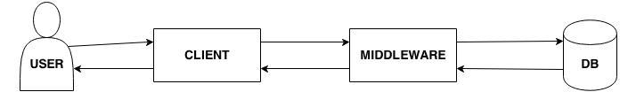
Overall System Architecture Diagram
Three Tier Architecture
(Web Browser for PC)
(Django Web Framework)

Slide 5
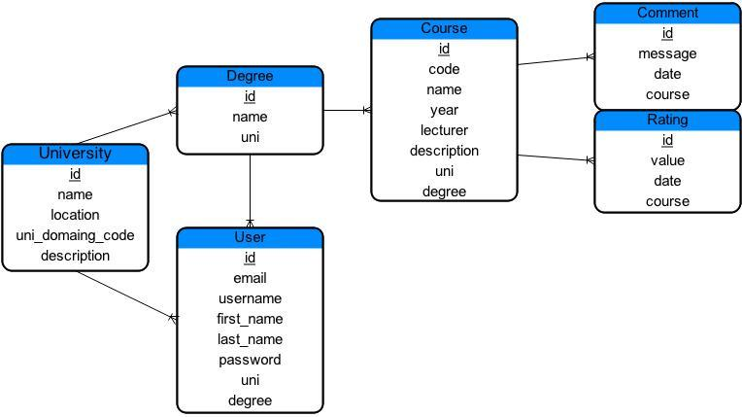
ER Diagram

Slide 6
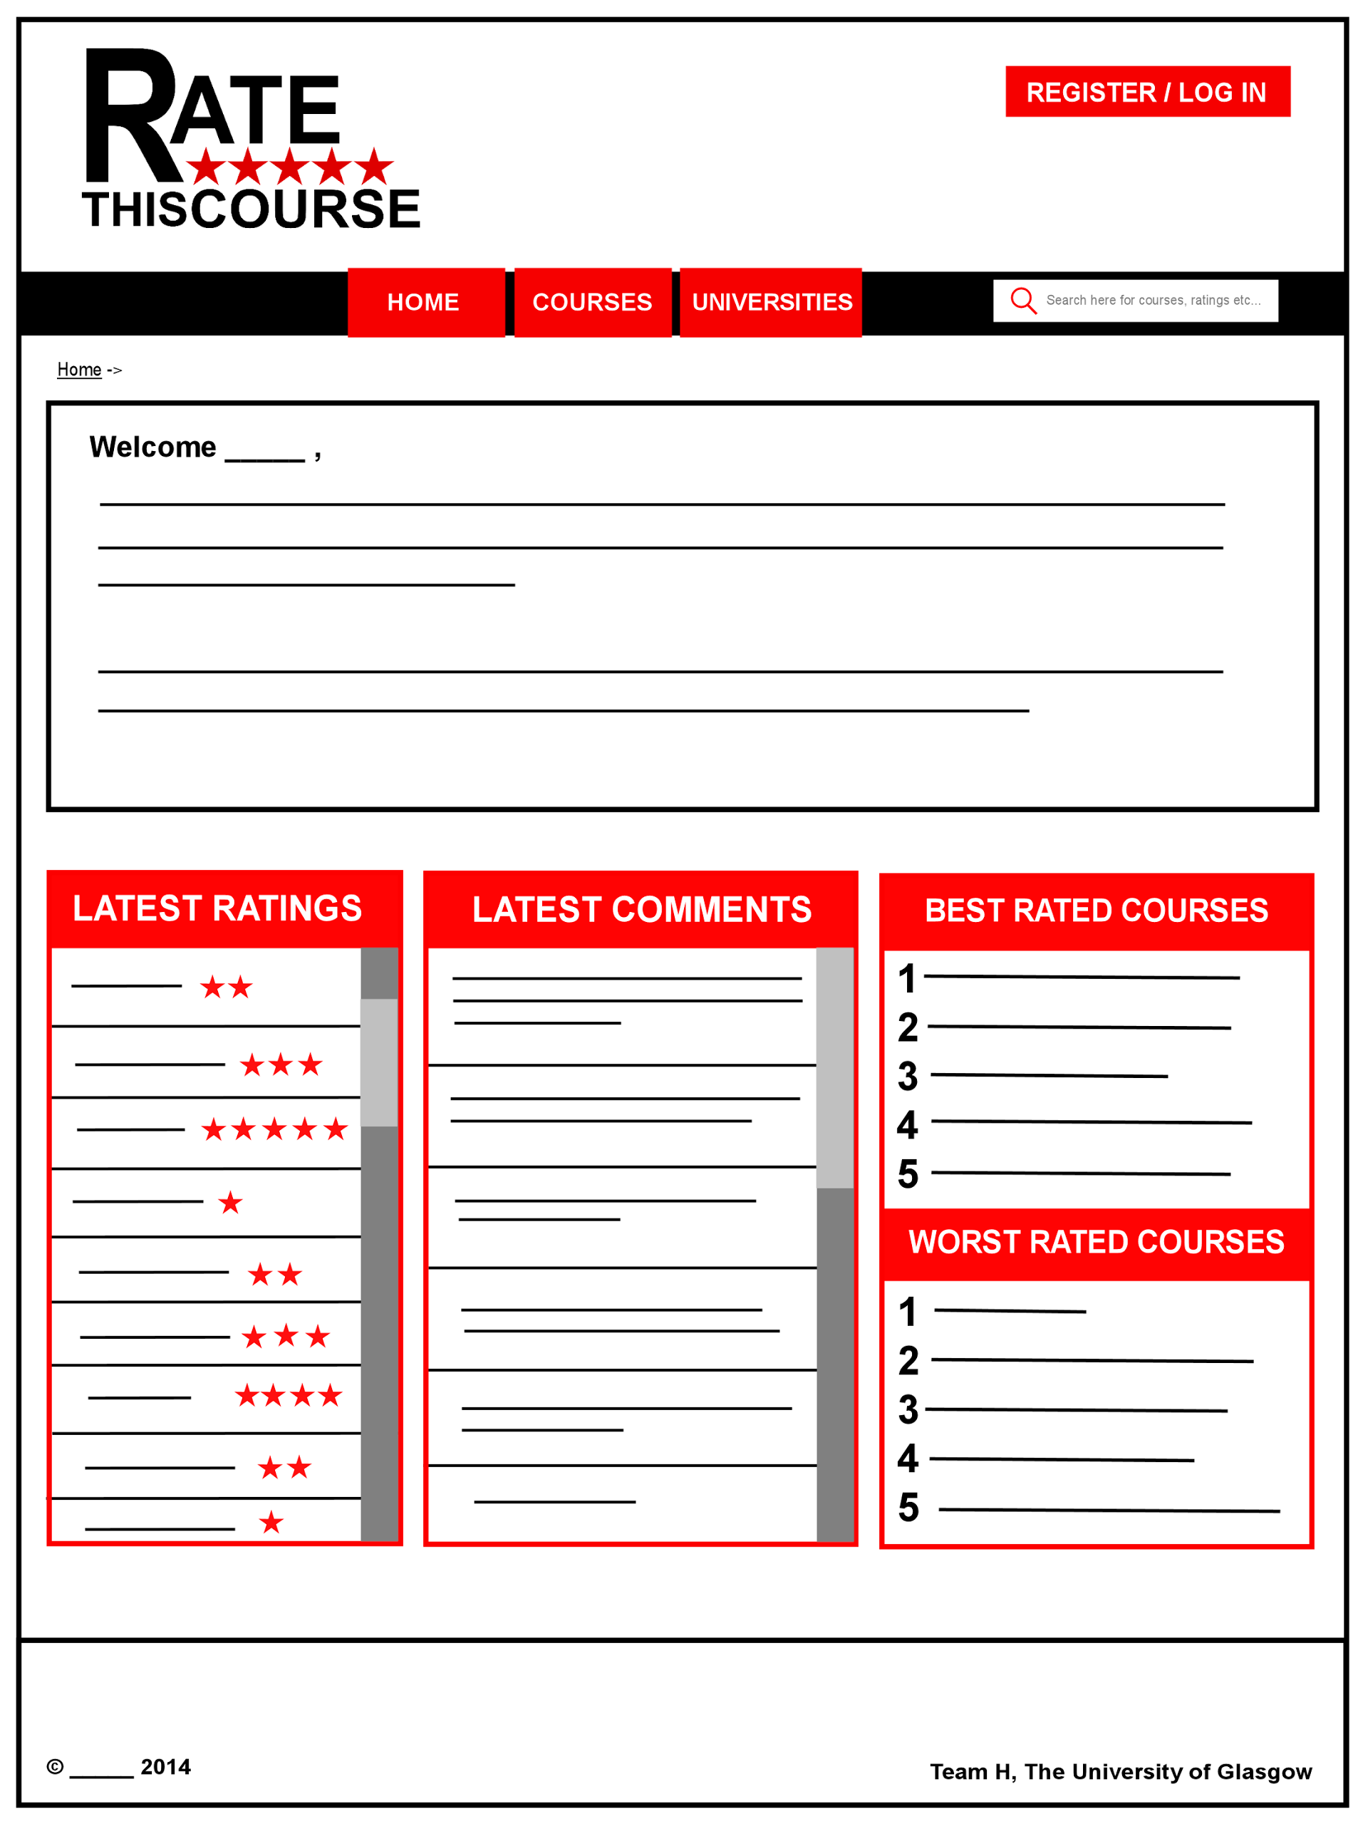
Wireframes

Slide 7
Wireframes : Home Page
Website header/ logo
Takes the user to the login/registration page
Buttons to other pages
Search bar
Site map
Welcome page
information. Includes
information about how to
use the website,
List of latest ratings
Components that show
the best and worst rated
courses
List of latest comments
Copyright and team information

Slide 8
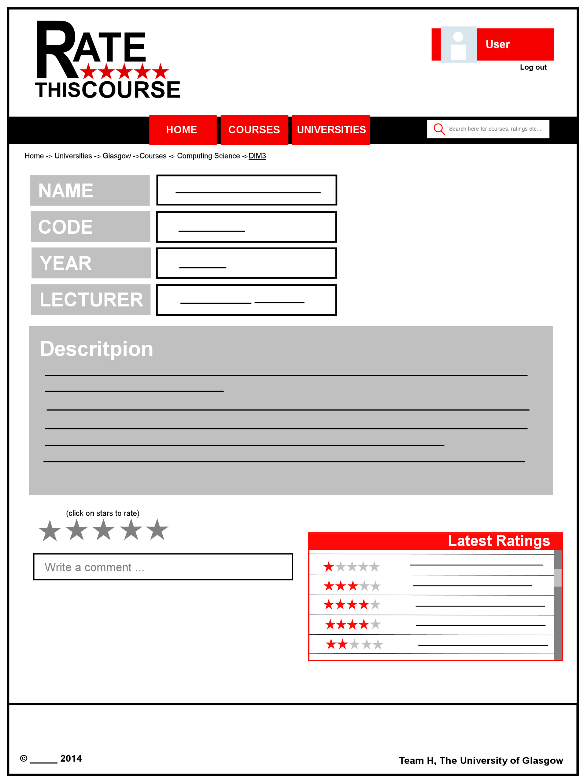
Wireframes : Course Page
Site map
Logged in user view. When you click on the user name it should take you to the user’s profile
Course information
Rating component. User can rate a course from 1 to 5 stars
Latest rating/comments of this course
Comment component

Slide 9

User Personas: 1
Key Functions
Ellen
2nd year student
Critical needs:
Read comments
View best rated courses
Opr. to improve:
Provide best/worst
Sort courses by ratings
CompSci student, Ellen is looking for courses to enroll on for this academic year. A bit paranoid, never rates a course she has attended nor comments. Wants to enjoy second year without too much work

Slide 10

User Personas: 2
Jon Brown
Key Functions
Critical needs:
Reads comments/Views ratings for all computing courses
Opr. to improve:
Degree specific categories
Different sorting methods for courses
Staff member
Jon Brown is a lecturer at Bornemouth university. He cares about his students and would like to involve them in different activities which
the students will find interesting and will enhance their studies. He wants to be able to read reviews of the best and
worst rated courses to get ideas on how to improve his teaching methods

Slide 11
User Needs Matrix
I want to... | Ellen | Oak | Jack
Rate a course | 2 | 1 | 5
Comment on a course | 2 | 1 | 5
View ratings / comments for a course | 5 | 5 | 3
Find best rated courses | 4 | 5 | 2
Find a list of courses / universities | 4 | 5 | 2
5- important
1-not necessarily

Slide 12
URL Design
Home Page: http://somedomain/rate-my-course/
Register Page: http://somedomain/rate-my-course/register/
University List Page: http://somedomain/rate-my-course/university/
List of courses offered by a uni: http://somedomain/rate-my-course/university/<university>/
Modules List for a University/Course choice: http://somedomain/rate-my-course/university/<uni>/<course>/
Reviews and Ratings for a module: http://somedomain/rate-my-course/university/<uni>/<course>/<module>/
User Profile: http://somedomain/rate-my-course/user_profile/
Add Degree: http://somedomain/rate-my-course/add_degree/
Add Course: http://somedomain/rate-my-course/add_course

